Slide 1
Operating Systems

Slide 2
30. Condition Variables

Slide 3
Condition Variables
There are many cases where a thread wishes to check whether a condition is true before continuing its execution.
Example:
A parent thread might wish to check whether a child thread has completed.
This is often called a join().

Slide 4
Condition Variables
A Parent Waiting For Its Child
1 void *child(void *arg) {
2 printf("child\n");
3 // XXX how to indicate we are done?
4 return NULL;
5 }
6
7 int main(int argc, char *argv[]) {
8 printf("parent: begin\n");
9 pthread_t c;
10 Pthread_create(&c, NULL, child, NULL); // create child
11 // XXX how to wait for child?
12 printf("parent: end\n");
13 return 0;
14 }
What we would like to see here is:
parent: begin
child
parent: end

Slide 5
Parent waiting for child: Spin-based Approach
This is hugely inefficient as the parent spins and wastes CPU time.
1 volatile int done = 0;
2
3 void *child(void *arg) {
4 printf("child\n");
5 done = 1;
6 return NULL;
7 }
8
9 int main(int argc, char *argv[]) {
10 printf("parent: begin\n");
11 pthread_t c;
12 Pthread_create(&c, NULL, child, NULL); // create child
13 while (done == 0)
14 ; // spin
15 printf("parent: end\n");
16 return 0;
17 }

Slide 6
How to wait for a condition
Condition variable
Queue of threads
Waiting on the condition
An explicit queue that threads can put themselves on when some state of execution is not as desired.
Signaling on the condition
Some other thread, when it changes it state, can wake one of those waiting threads and allow them to continue.
Three in a package
condition variable c
state variable m
lock L; // to protect state variable

Slide 7
Definition and Routines
Declare condition variable
Proper initialization is required.
Operation (the POSIX calls)
The wait() call takes a mutex as a parameter.
The wait() call release the lock and put the calling thread to sleep.
When the thread wakes up, it must re-acquire the lock.
pthread cond t c;
pthread_cond_wait(pthread_cond_t *c, pthread_mutex_t *m); // wait()
pthread_cond_signal(pthread_cond_t *c); // signal()

Slide 8
Parent waiting for Child: Use a condition variable
1 int done = 0;
2 pthread_mutex_t m = PTHREAD_MUTEX_INITIALIZER;
3 pthread_cond_t c = PTHREAD_COND_INITIALIZER;
4
5 void thr_exit() {
6 Pthread_mutex_lock(&m);
7 done = 1;
8 Pthread_cond_signal(&c);
9 Pthread_mutex_unlock(&m);
10 }
11
12 void *child(void *arg) {
13 printf("child\n");
14 thr_exit();
15 return NULL;
16 }
17
18 void thr_join() {
19 Pthread_mutex_lock(&m);
20 while (done == 0)
21 Pthread_cond_wait(&c, &m);
22 Pthread_mutex_unlock(&m);
23 }
24

Slide 9
Parent waiting for Child: Use a condition variable
(cont.)
25 int main(int argc, char *argv[]) {
26 printf("parent: begin\n");
27 pthread_t p;
28 Pthread_create(&p, NULL, child, NULL);
29 thr_join();
30 printf("parent: end\n");
31 return 0;
32 }

Slide 10
Parent waiting for Child: Use a condition variable
Parent:
Creates the child thread and continues running itself.
Calls into thr_join() to wait for the child thread to complete.
Acquires the lock.
Checks if the child is done.
Puts itself to sleep by calling wait().
Releases the lock.
Child:
Prints the message “child”.
Calls thr_exit() to wake up the parent thread.
Grabs the lock.
Sets the state variable done.
Signals the parent thus waking it.

Slide 11
The importance of the state variable done
Imagine the case where the child runs immediately.
The child will signal, but there is no thread asleep on the condition.
When the parent runs, it will call wait and be stuck.
No thread will ever wake it.
1 void thr_exit() {
2 Pthread_mutex_lock(&m);
3 Pthread_cond_signal(&c);
4 Pthread_mutex_unlock(&m);
5 }
6
7 void thr_join() {
8 Pthread_mutex_lock(&m);
9 Pthread_cond_wait(&c, &m);
10 Pthread_mutex_unlock(&m);
11 }
thr_exit() and thr_join() without variable done

Slide 12
Another poor implementation
1 void thr_exit() {
2 done = 1;
3 Pthread_cond_signal(&c);
4 }
5
6 void thr_join() {
7 if (done == 0)
8 Pthread_cond_wait(&c);
9 }
The issue here is a subtle race condition.
The parent calls thr_join().
The parent checks the value of done.
It will see that it is 0 and try to go to sleep.
Just before it calls wait to go to sleep, the parent is interrupted and the child runs.
The child changes the state variable done to 1 and signals.
But no thread is waiting and thus no thread is woken.
When the parent runs again, it sleeps forever.

Slide 13
The Producer / Consumer (Bound Buffer) Problem
Producer
Produce data items
Wish to place data items in a buffer
Consumer
Grab data items out of the buffer consume them in some way
Example: Multi-threaded web server
A producer puts HTTP requests in to a work queue
Consumer threads take requests out of this queue and process them

Slide 14
Bounded buffer
A bounded buffer is used when you pipe the output of one program into another.
Example: grep foo file.txt | wc –l
The grep process is the producer.
The wc process is the consumer.
Between them is an in-kernel bounded buffer.
Bounded buffer is Shared resource → Synchronized access is required.

Slide 15
The Put and Get Routines (Version 1)
Only put data into the buffer when count is zero.
i.e., when the buffer is empty.
Only get data from the buffer when count is one.
i.e., when the buffer is full.
1 int buffer;
2 int count = 0; // initially, empty
3
4 void put(int value) {
5 assert(count == 0);
6 count = 1;
7 buffer = value;
8 }
9
10 int get() {
11 assert(count == 1);
12 count = 0;
13 return buffer;
14 }

Slide 16
Producer/Consumer Threads (Version 1)
Producer puts an integer into the shared buffer loops number of times.
Consumer gets the data out of that shared buffer.
1 void *producer(void *arg) {
2 int i;
3 int loops = (int) arg;
4 for (i = 0; i < loops; i++) {
5 put(i);
6 }
7 }
8
9 void *consumer(void *arg) {
10 int i;
11 while (1) {
12 int tmp = get();
13 printf("%d\n", tmp);
14 }
15 }

Slide 17
Producer/Consumer: Single CV and If Statement
A single condition variable cond and associated lock mutex
1 cond_t cond;
2 mutex_t mutex;
3
4 void *producer(void *arg) {
5 int i;
6 for (i = 0; i < loops; i++) {
7 Pthread_mutex_lock(&mutex); // p1
8 if (count == 1) // p2
9 Pthread_cond_wait(&cond, &mutex); // p3
10 put(i); // p4
11 Pthread_cond_signal(&cond); // p5
12 Pthread_mutex_unlock(&mutex); // p6
13 }
14 }
15

Slide 18
Producer/Consumer: Single CV and If Statement
16 void *consumer(void *arg) {
17 int i;
18 for (i = 0; i < loops; i++) {
19 Pthread_mutex_lock(&mutex); // c1
20 if (count == 0) // c2
21 Pthread_cond_wait(&cond, &mutex); // c3
22 int tmp = get(); // c4
23 Pthread_cond_signal(&cond); // c5
24 Pthread_mutex_unlock(&mutex); // c6
25 printf("%d\n", tmp);
26 }
27 }
p1-p3: A producer waits for the buffer to be empty.
c1-c3: A consumer waits for the buffer to be full.
With just a single producer and a single consumer, the code works.
If we have more than one of producer and consumer?

Slide 19
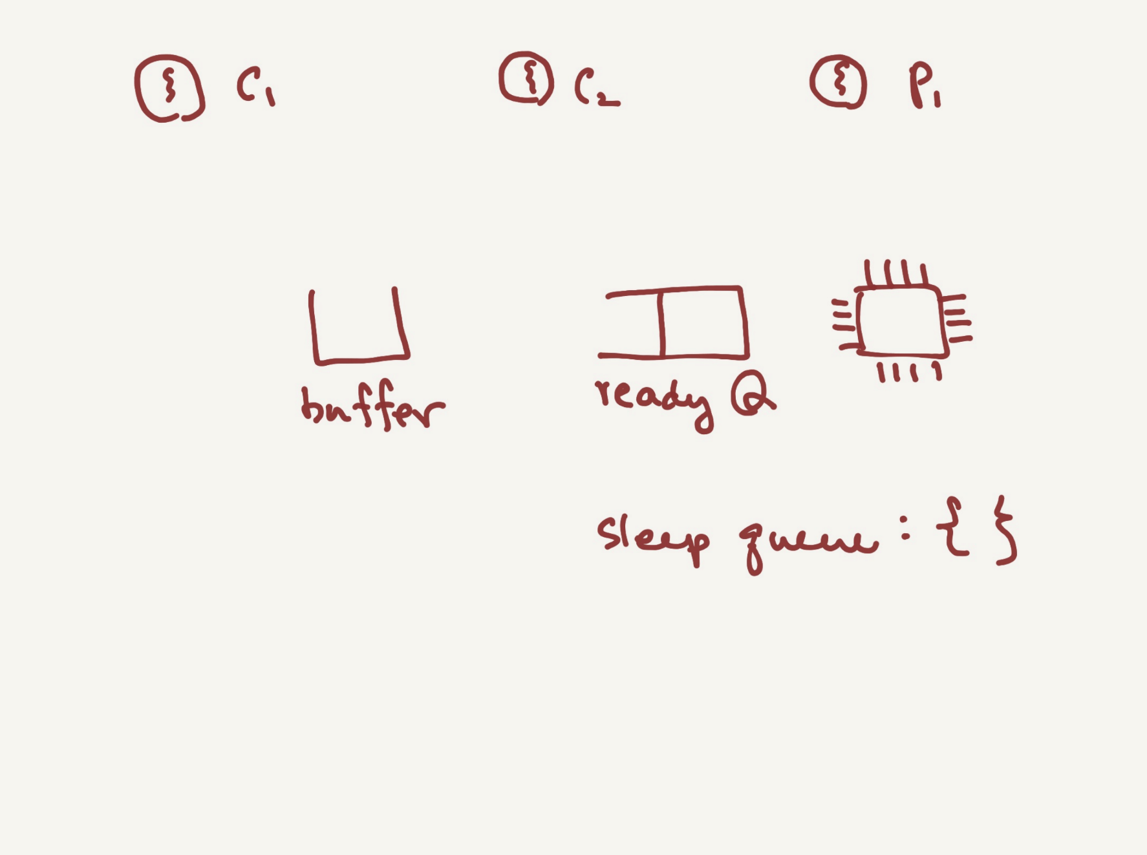

Slide 20
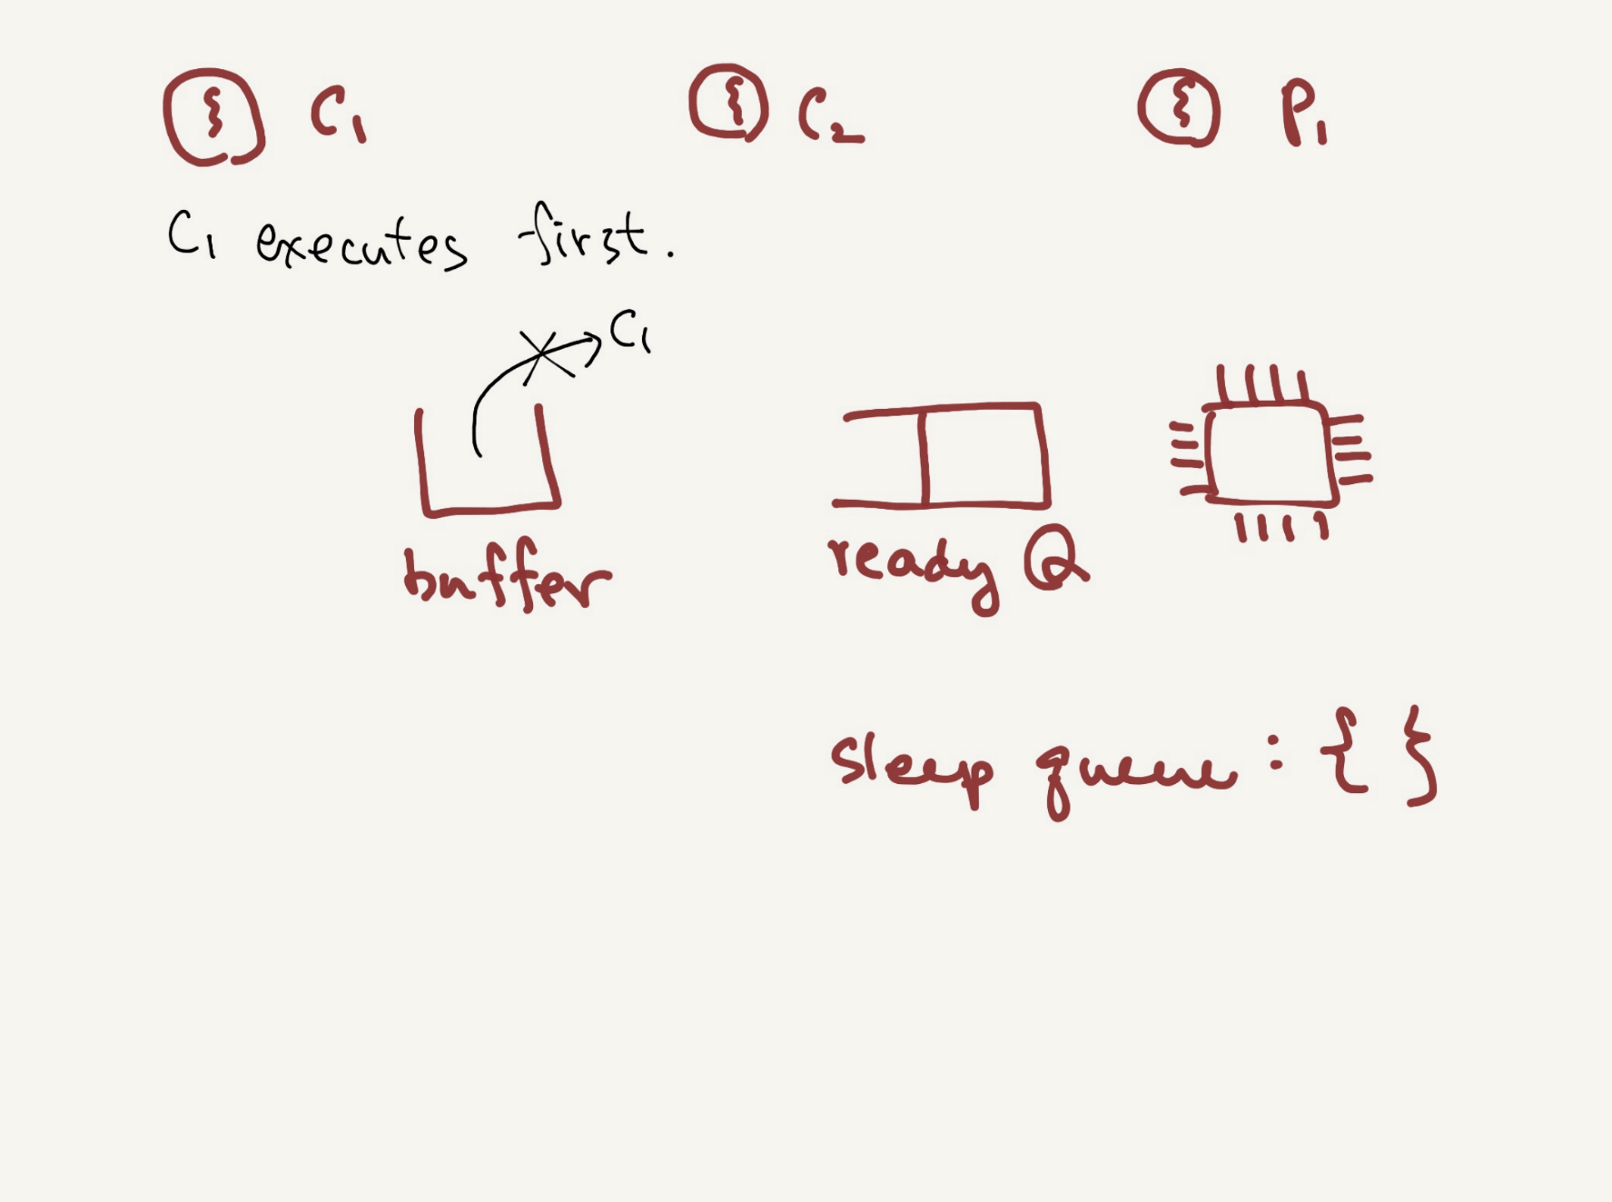

Slide 21
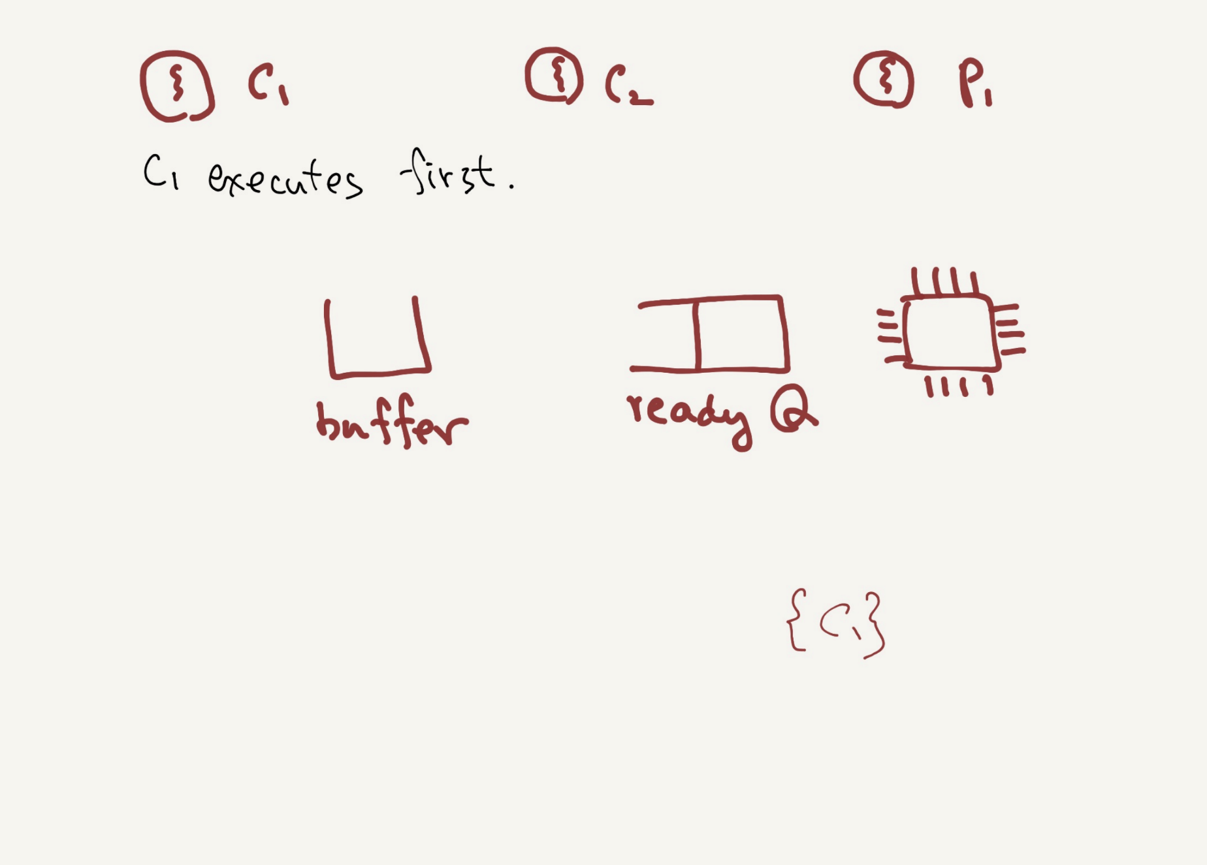

Slide 22
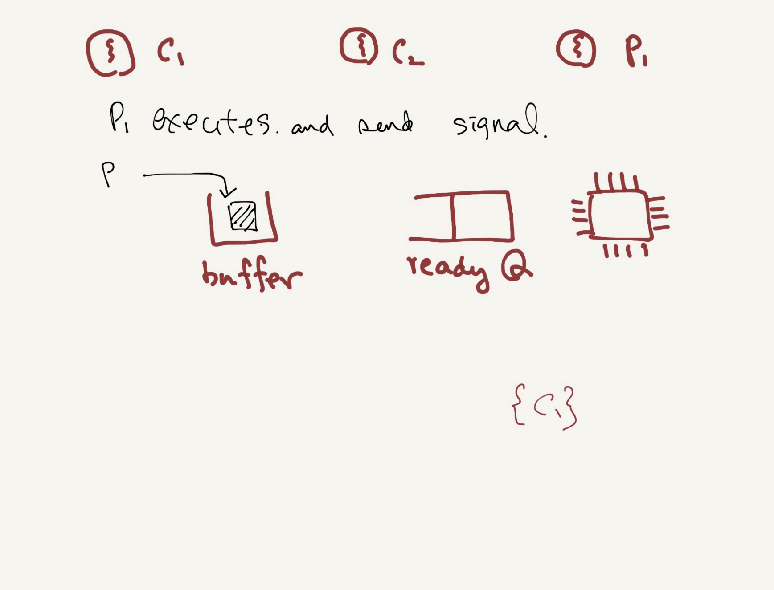

Slide 23
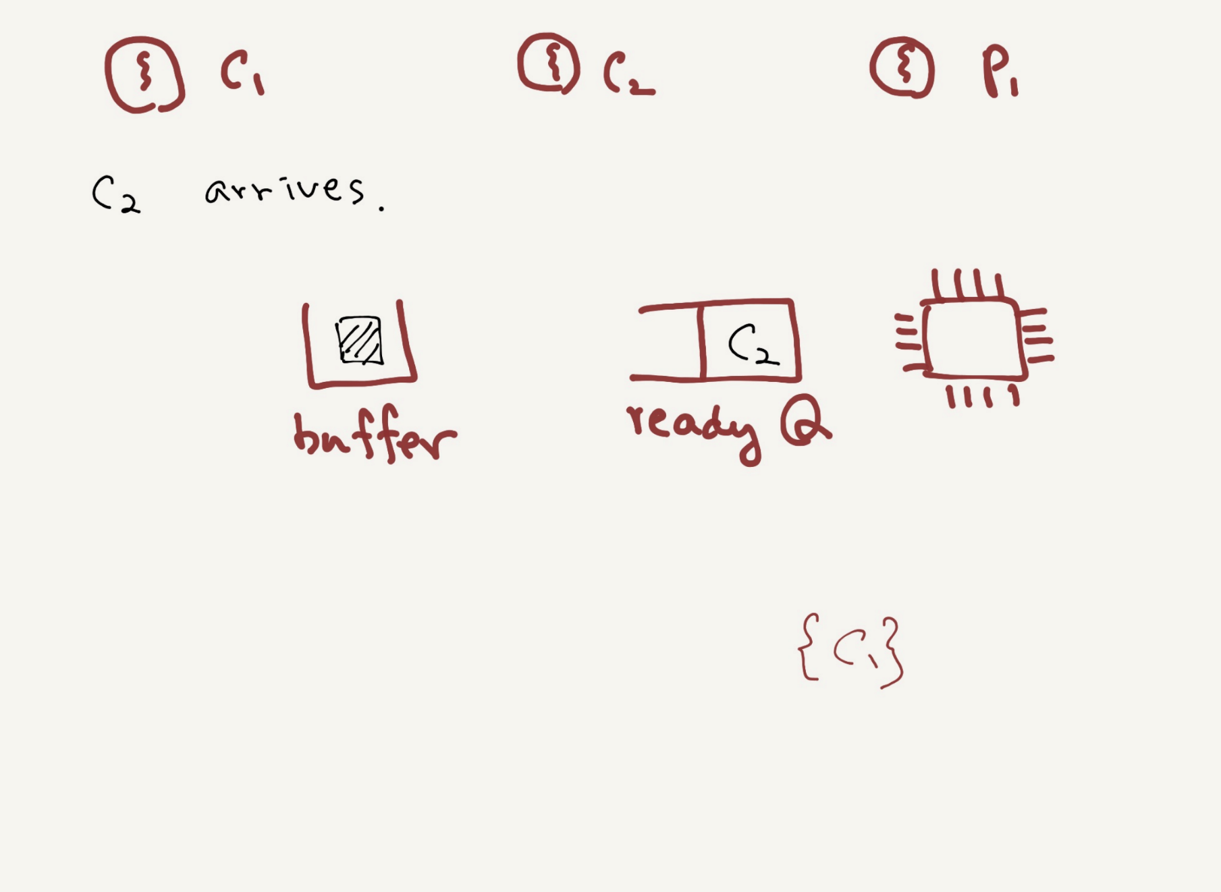

Slide 24
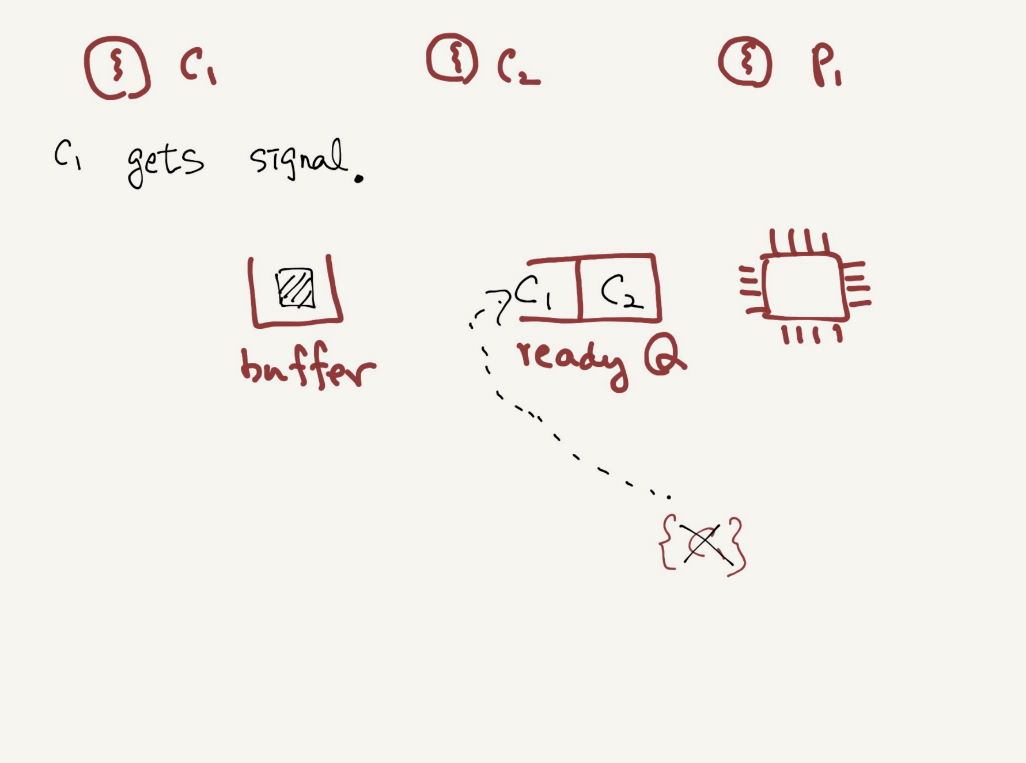

Slide 25
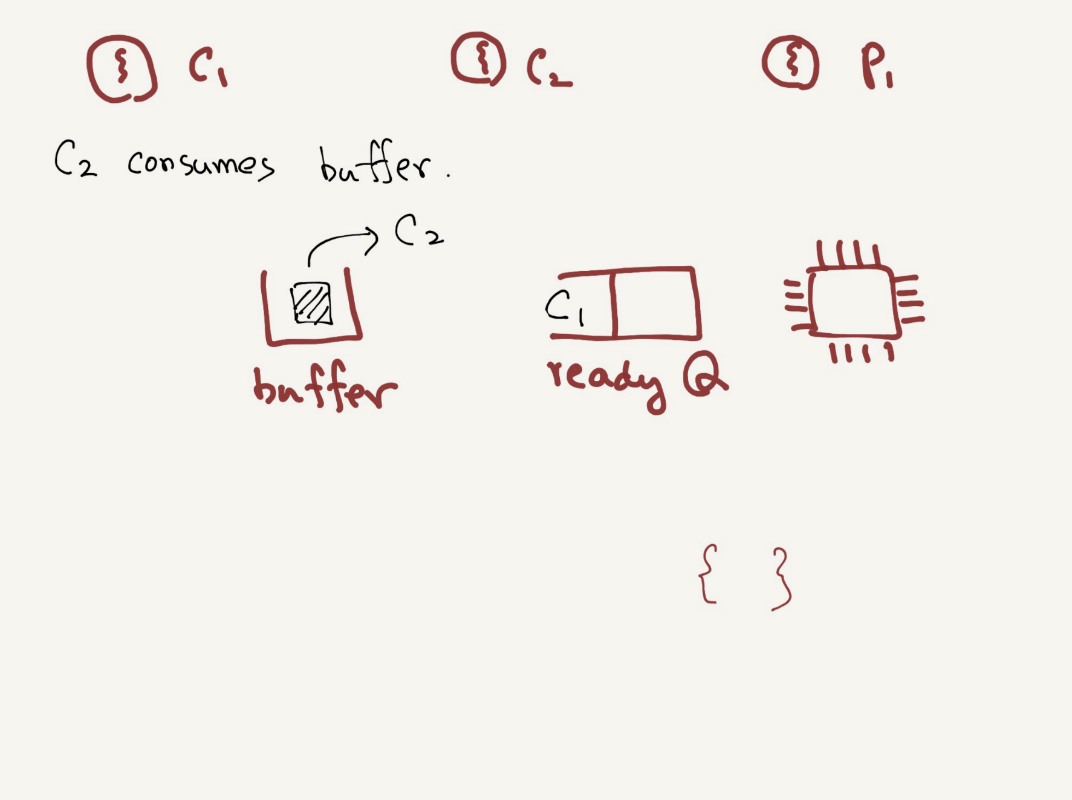

Slide 26
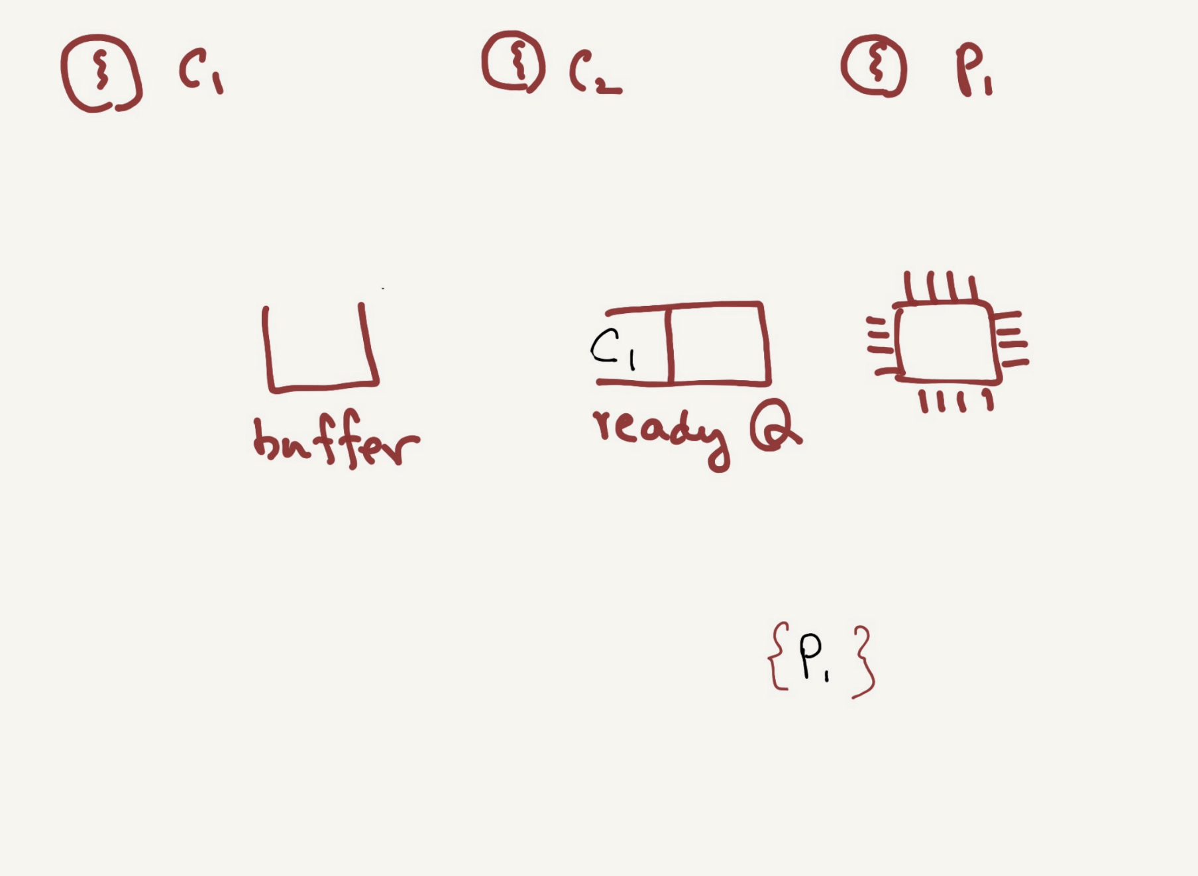

Slide 27
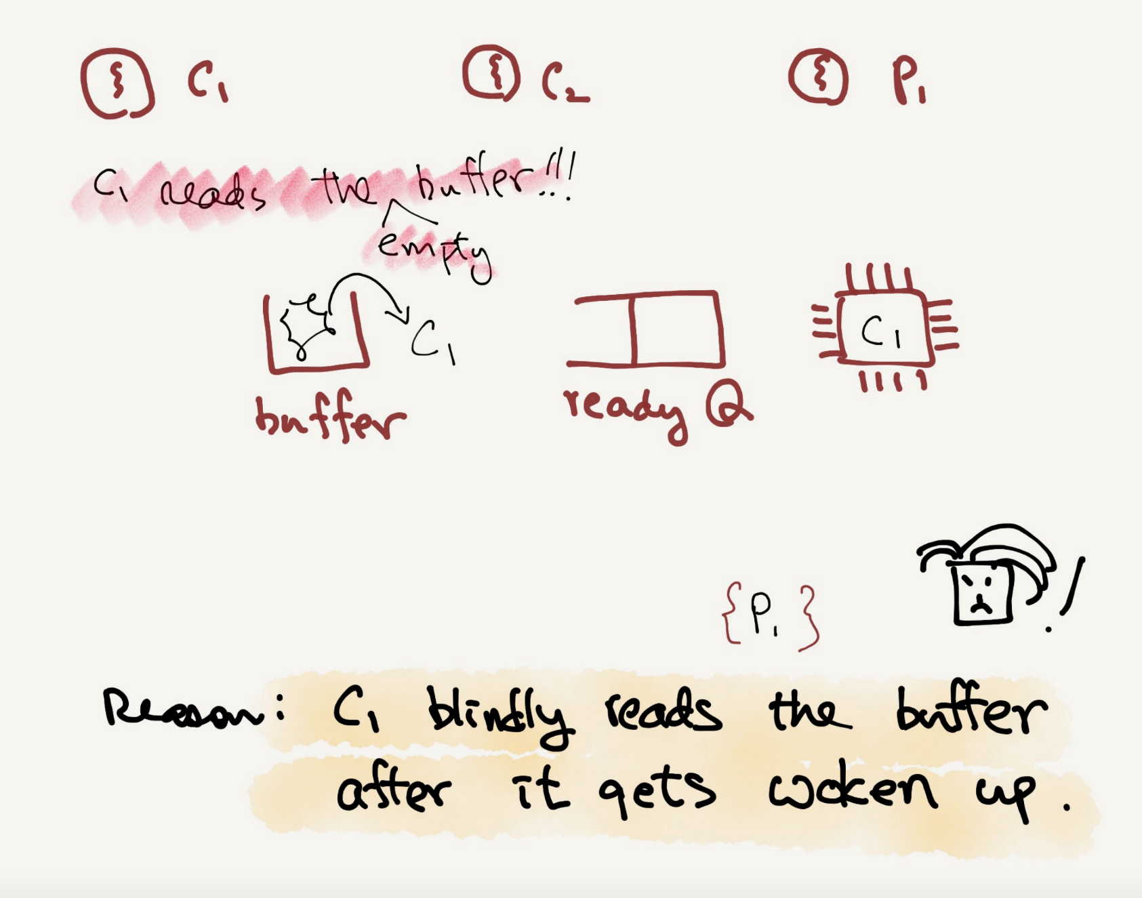

Slide 28
Thread Trace: Broken Solution (Version 1)
 | State |  | State |  | State | Count | Comment
c1 | Running |  | Ready |  | Ready | 0
c2 | Running |  | Ready |  | Ready | 0
c3 | Sleep |  | Ready |  | Ready | 0 | Nothing to get
 | Sleep |  | Ready | p1 | Running | 0
 | Sleep |  | Ready | p2 | Running | 0
 | Sleep |  | Ready | p4 | Running | 1 | Buffer now full
 | Ready |  | Ready | p5 | Running | 1 | awoken
 | Ready |  | Ready | p6 | Running | 1
 | Ready |  | Ready | p1 | Running | 1
 | Ready |  | Ready | p2 | Running | 1
 | Ready |  | Ready | p3 | Sleep | 1 | Buffer full; sleep
 | Ready | c1 | Running |  | Sleep | 1 | sneaks in …
 | Ready | c2 | Running |  | Sleep | 1
 | Ready | c4 | Running |  | Sleep | 0 | … and grabs data
 | Ready | c5 | Running |  | Ready | 0 | awoken
 | Ready | c6 | Running |  | Ready | 0
c4 | Running |  | Ready |  | Ready | 0 | Oh oh! No data

Slide 29

Thread Trace: Broken Solution (Version 1)
The problem arises for a simple reason:
After the producer woke $T_{c1}$, but before $T_{c1}$ ever ran, the state of the bounded buffer changed by $T_{c2}$.
There is no guarantee that when the woken thread runs, the state will still be as desired → Mesa semantics.
Virtually every system ever built employs Mesa semantics.
Hoare semantics provides a stronger guarantee that the woken thread will run immediately upon being woken.

Slide 30
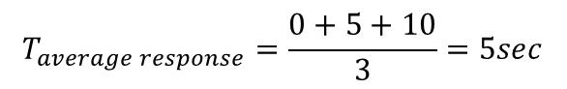
Producer/Consumer: Single CV and While
Consumer $T_{c1}$ wakes up and re-checks the state of the shared variable.
If the buffer is empty, the consumer simply goes back to sleep.
1 cond_t cond;
2 mutex_t mutex;
3
4 void *producer(void *arg) {
5 int i;
6 for (i = 0; i < loops; i++) {
7 Pthread_mutex_lock(&mutex); // p1
8 while (count == 1) // p2
9 Pthread_cond_wait(&cond, &mutex); // p3
10 put(i); // p4
11 Pthread_cond_signal(&cond); // p5
12 Pthread_mutex_unlock(&mutex); // p6
13 }
14 }
15

Slide 31
Producer/Consumer: Single CV and While
A simple rule to remember with condition variables is to always use while loops.
However, this code still has a bug (next page).
(Cont.)
16 void *consumer(void *arg) {
17 int i;
18 for (i = 0; i < loops; i++) {
19 Pthread_mutex_lock(&mutex); // c1
20 while (count == 0) // c2
21 Pthread_cond_wait(&cond, &mutex); // c3
22 int tmp = get(); // c4
23 Pthread_cond_signal(&cond); // c5
24 Pthread_mutex_unlock(&mutex); // c6
25 printf("%d\n", tmp);
26 }
27 }

Slide 32
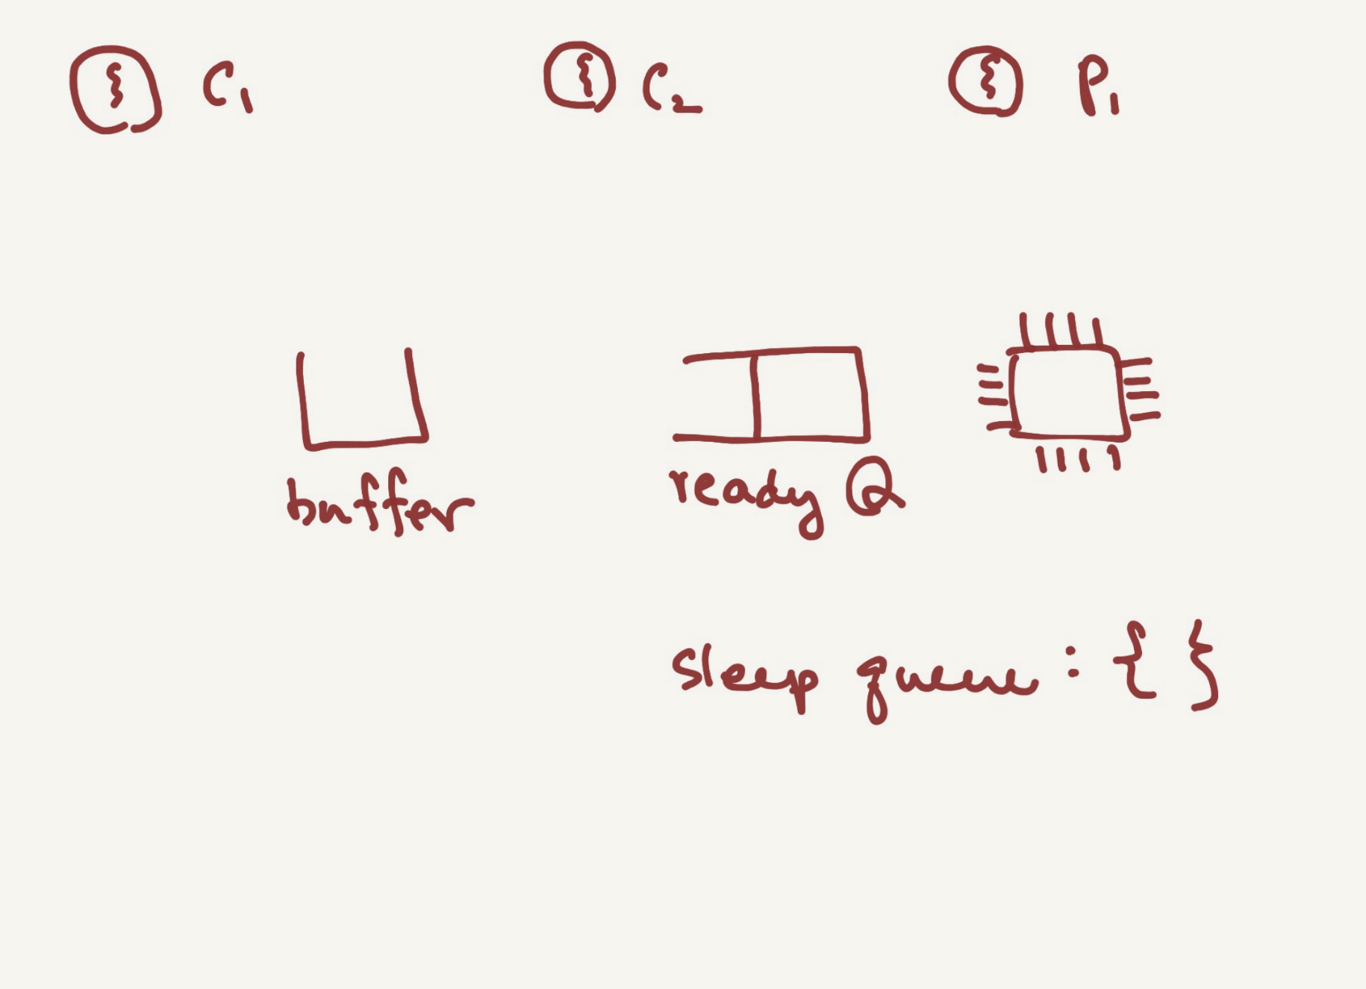

Slide 33
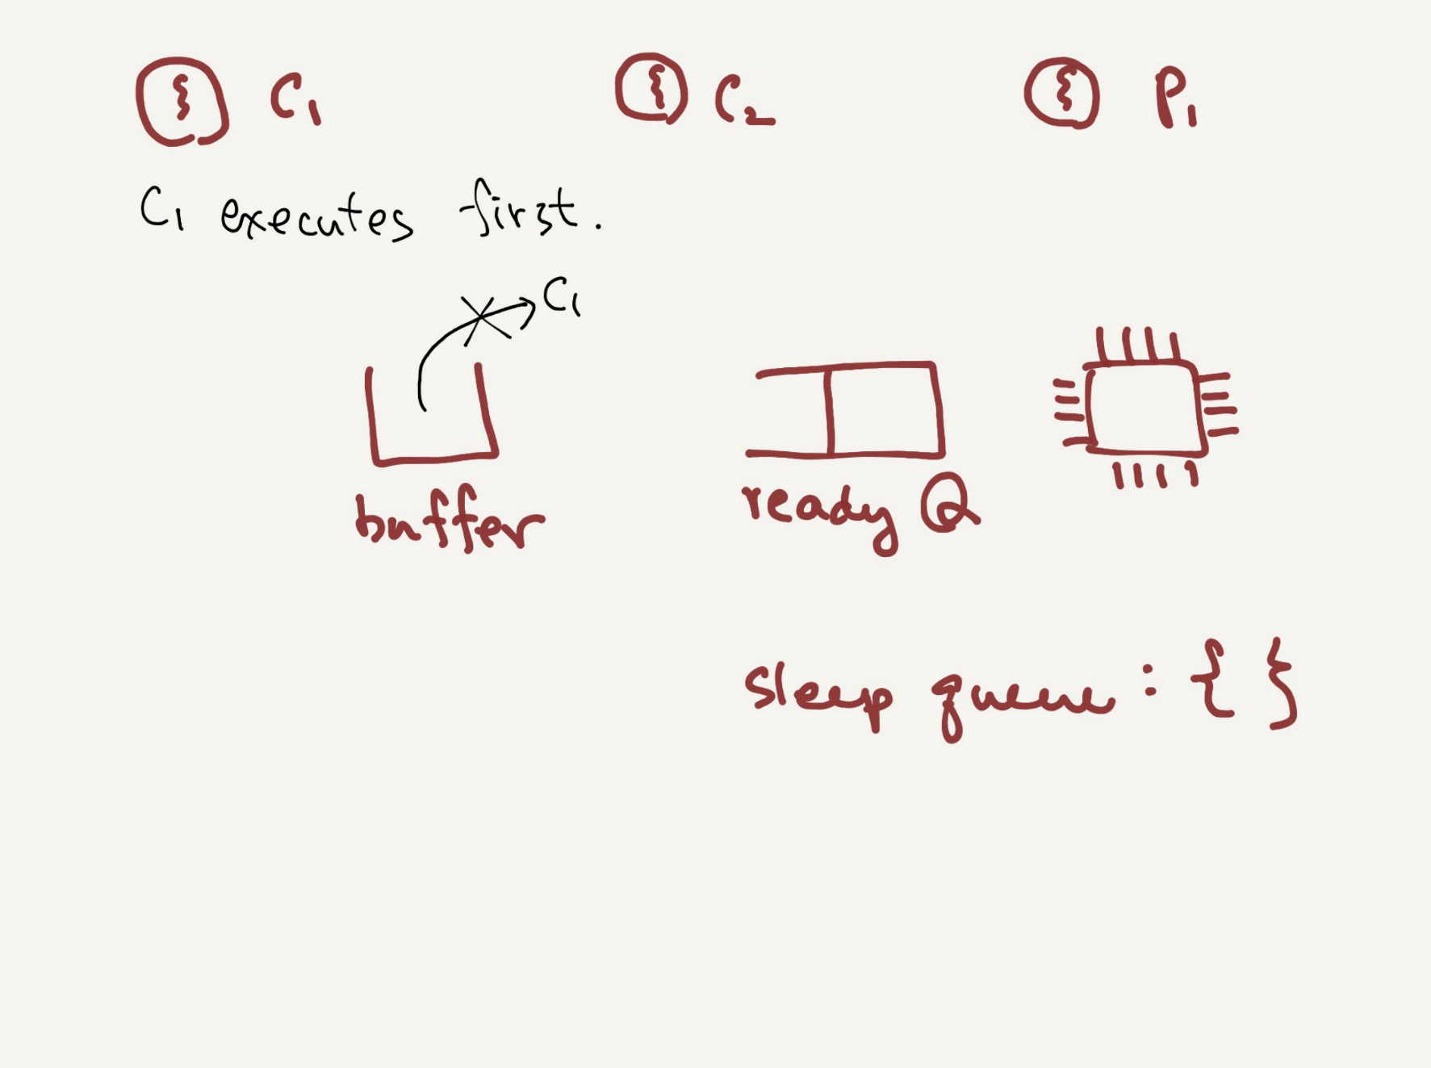

Slide 34
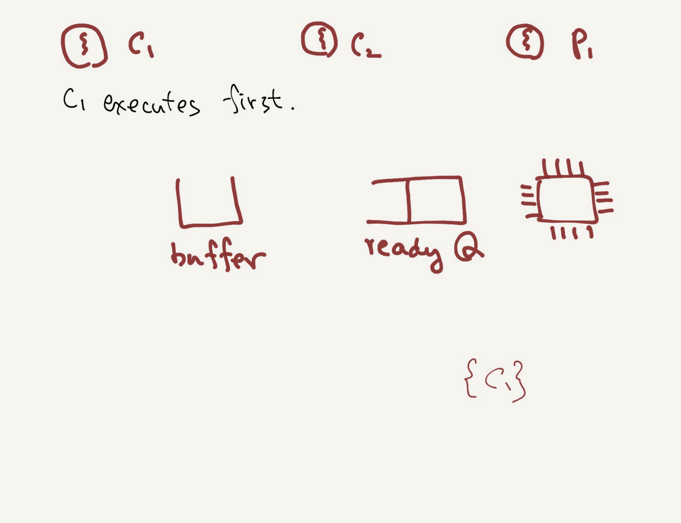

Slide 35
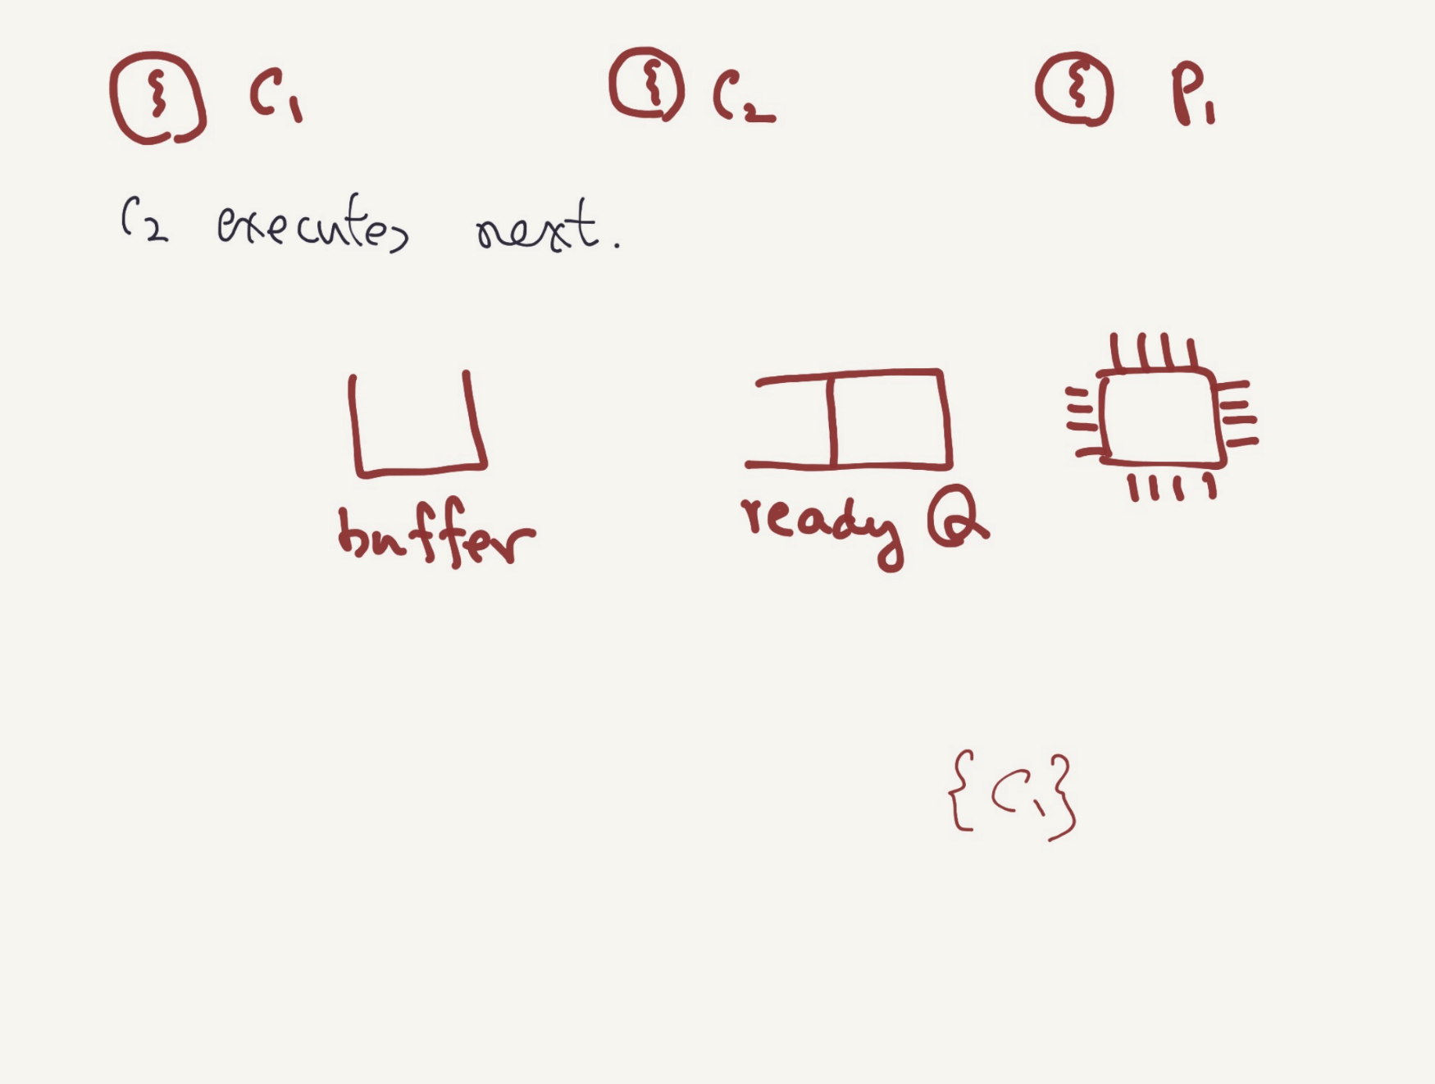

Slide 36
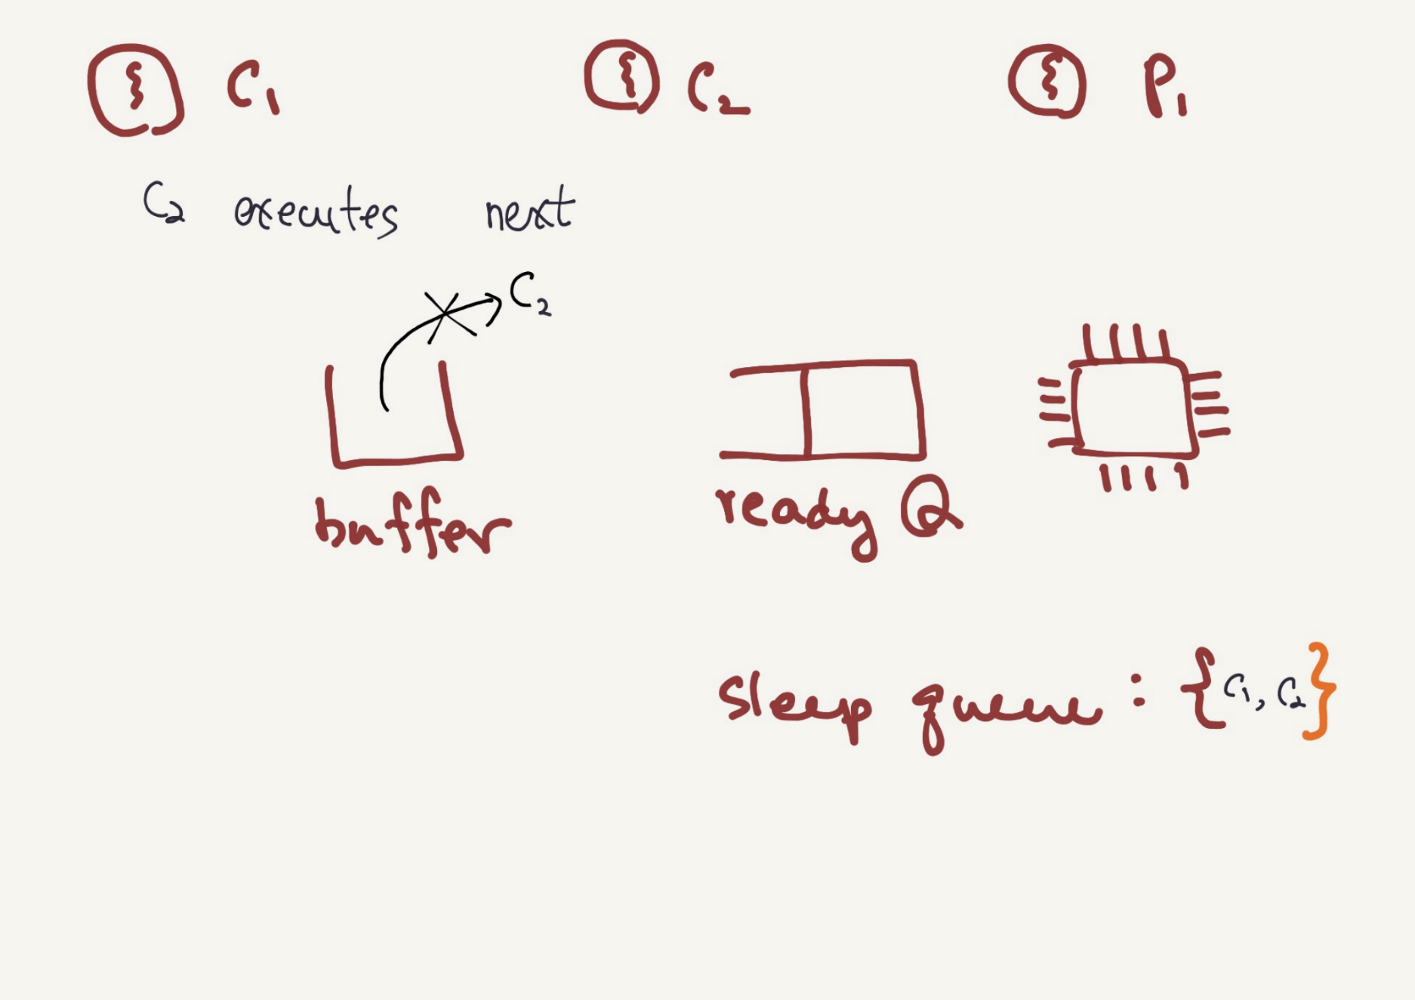

Slide 37
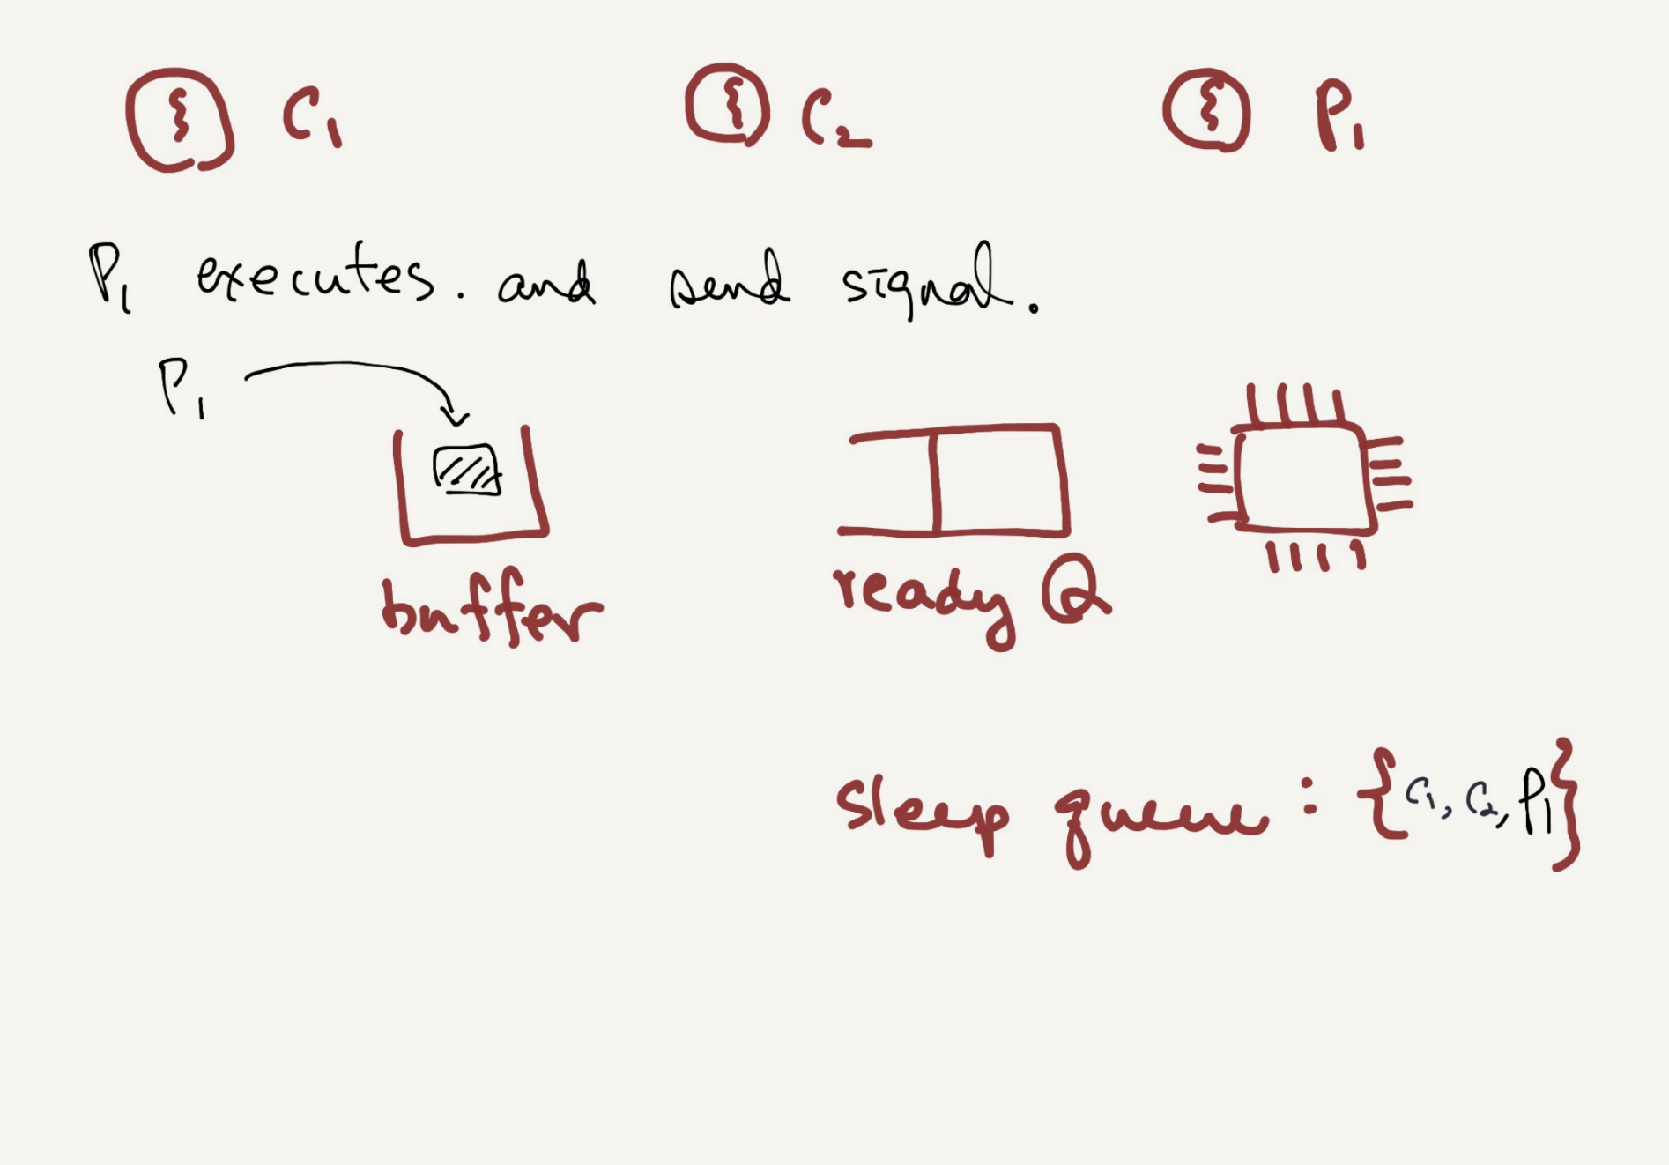

Slide 38
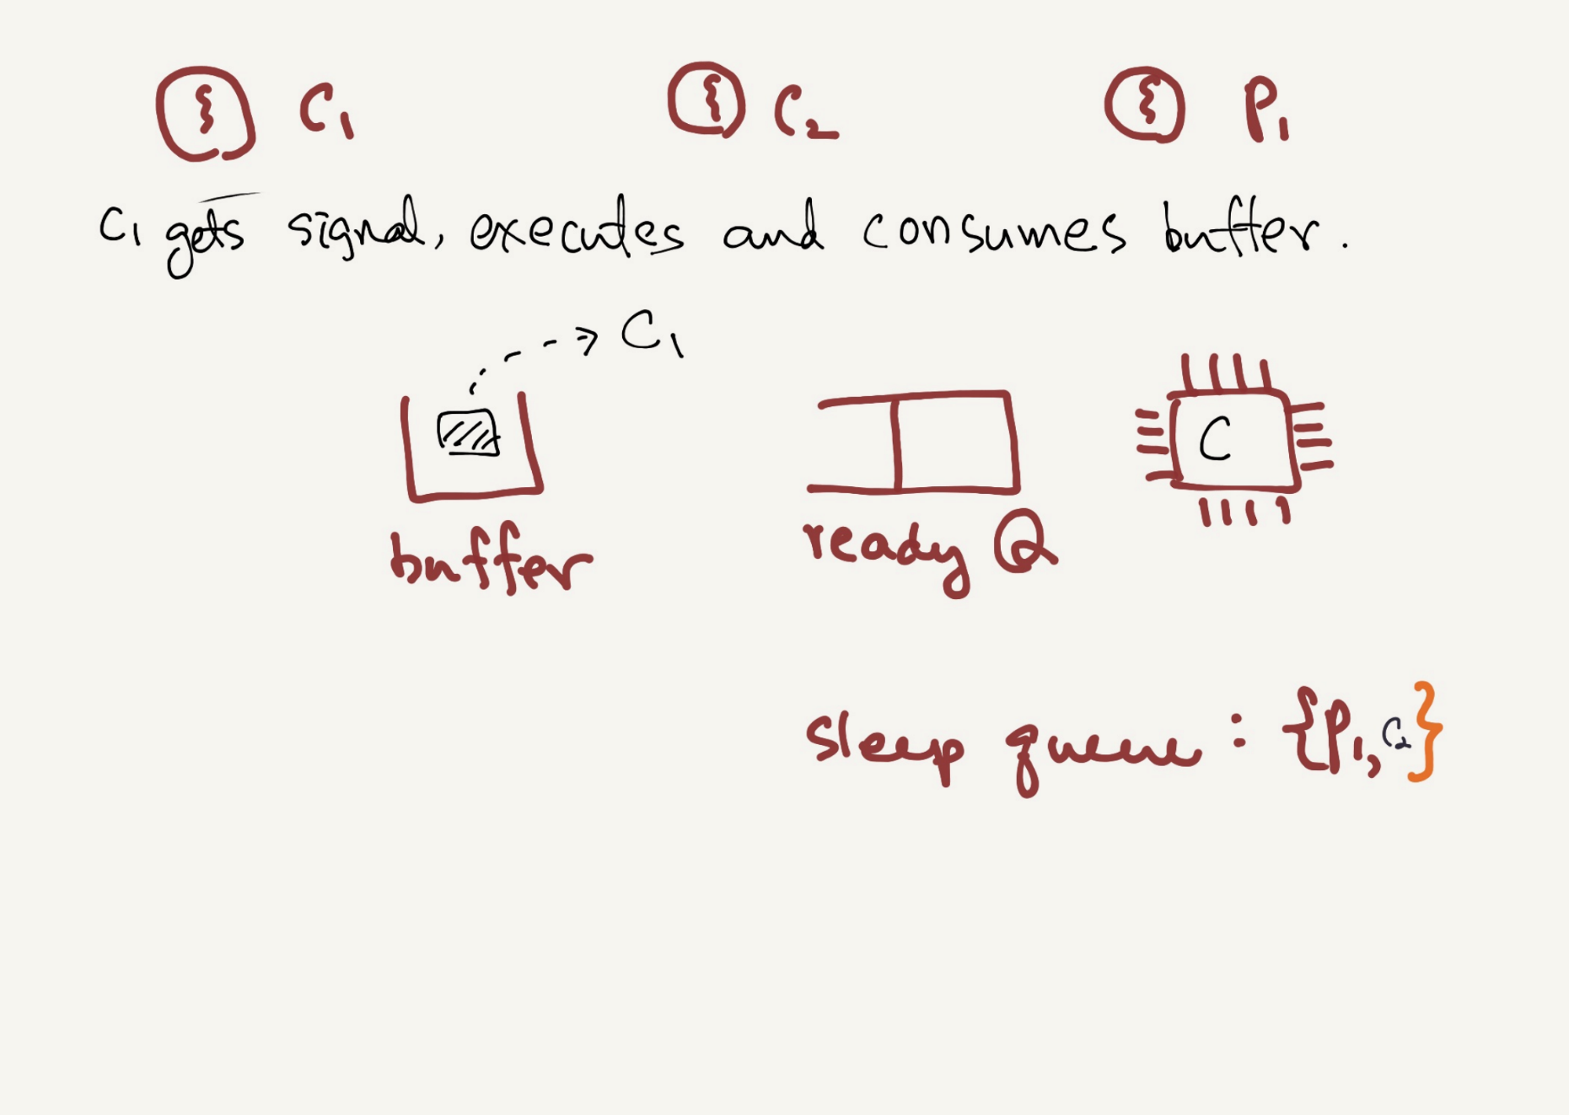

Slide 39
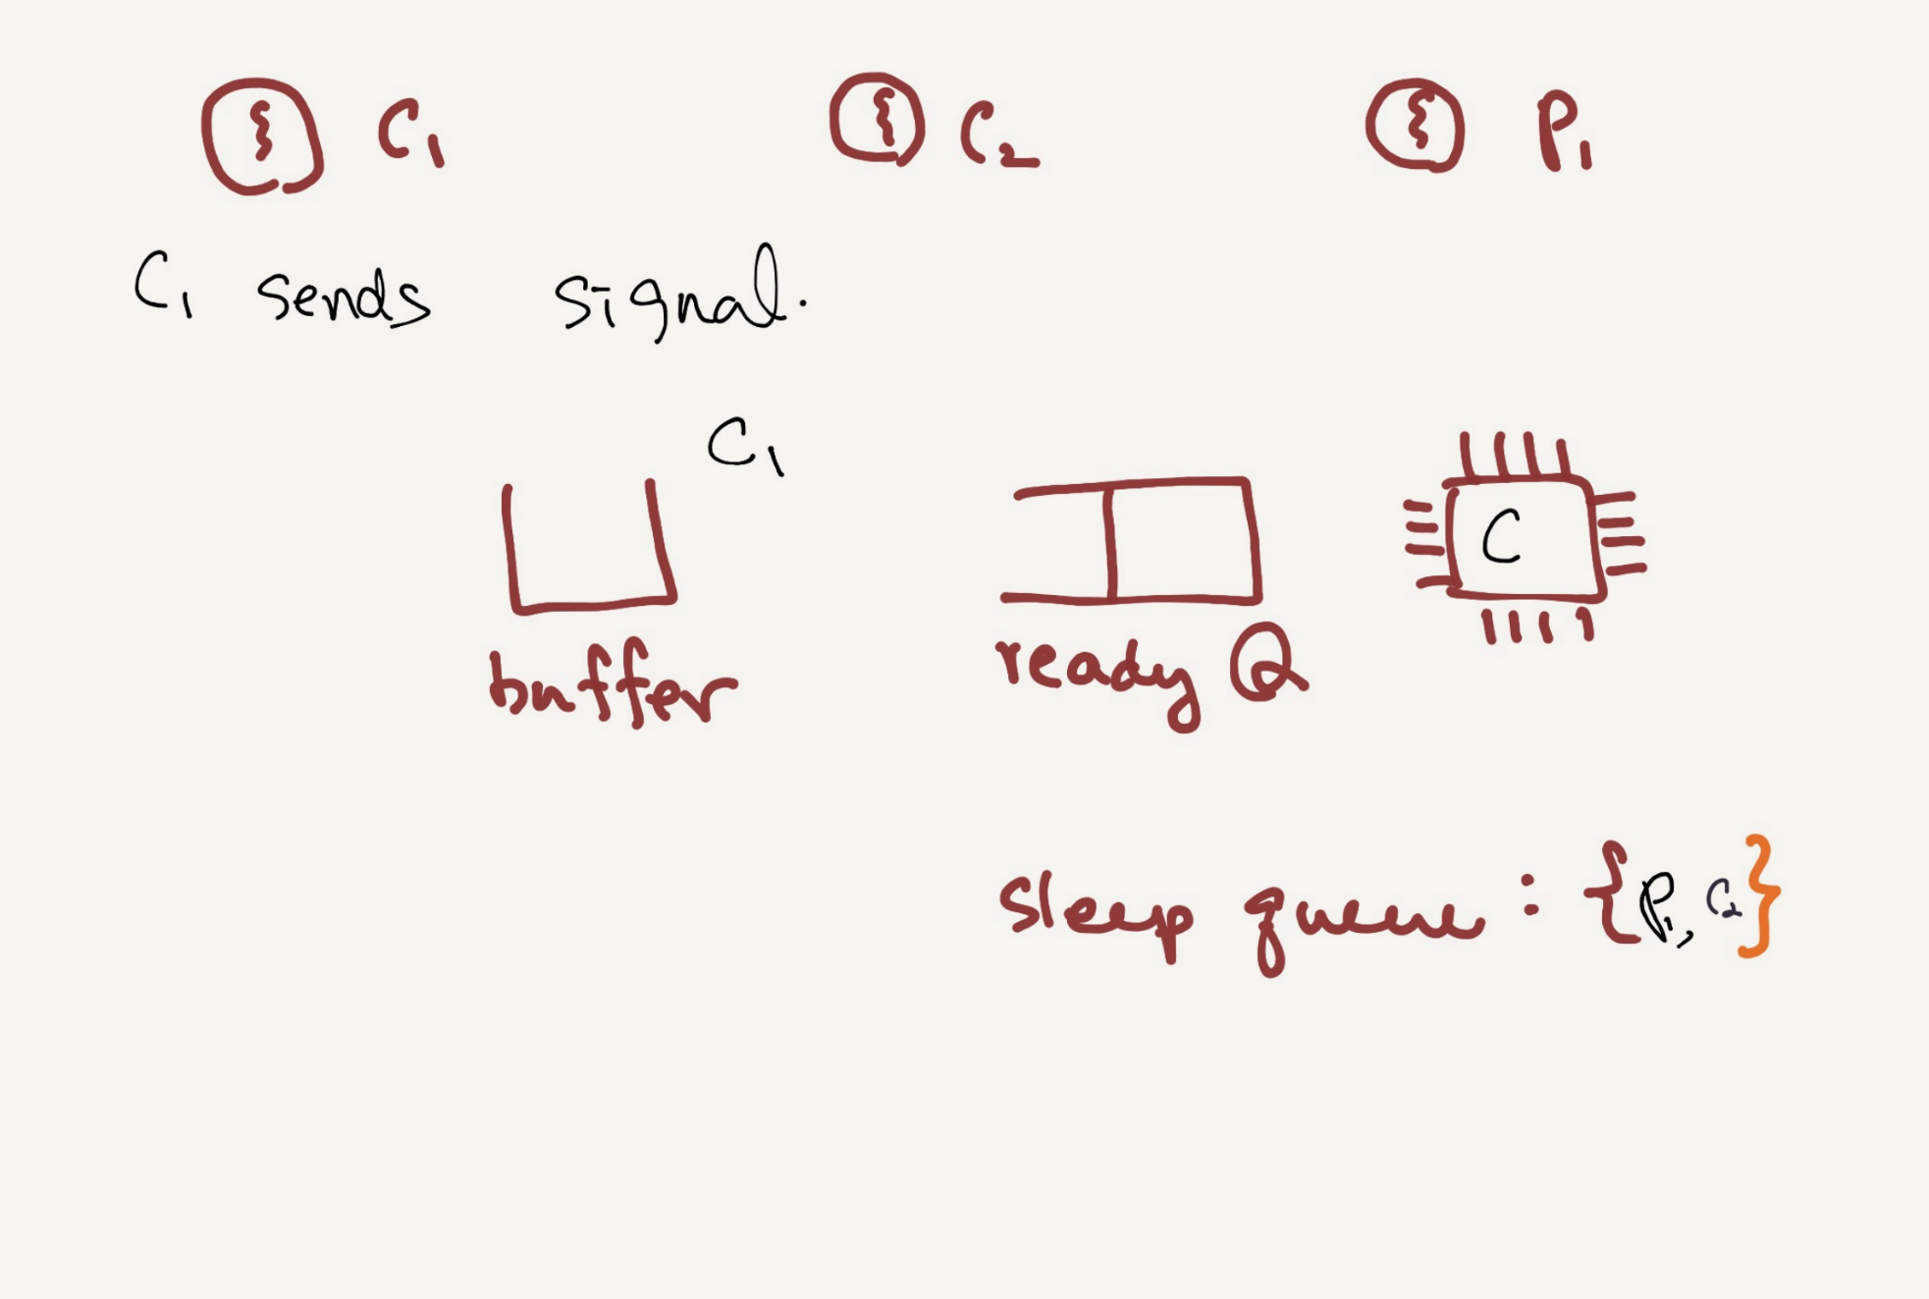

Slide 40
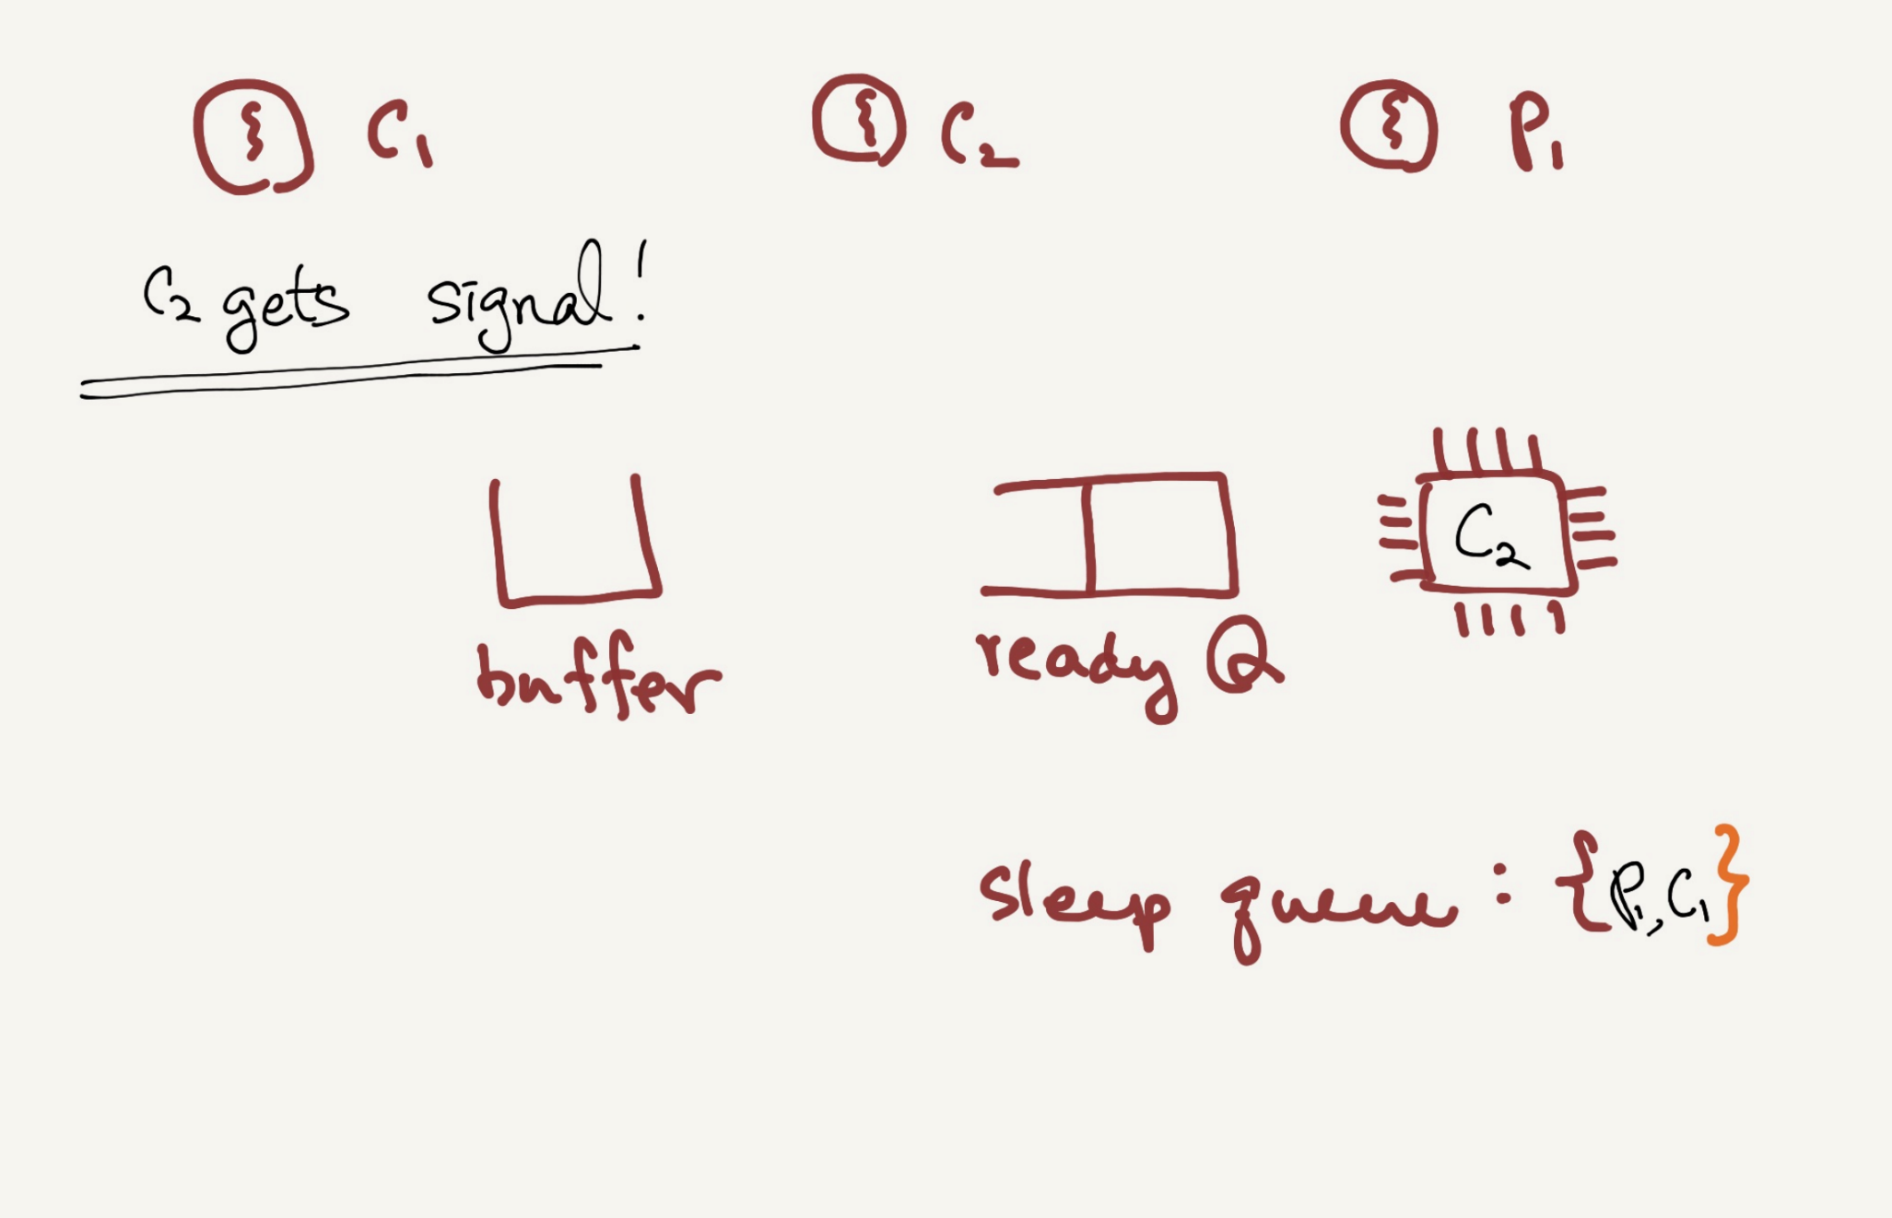

Slide 41
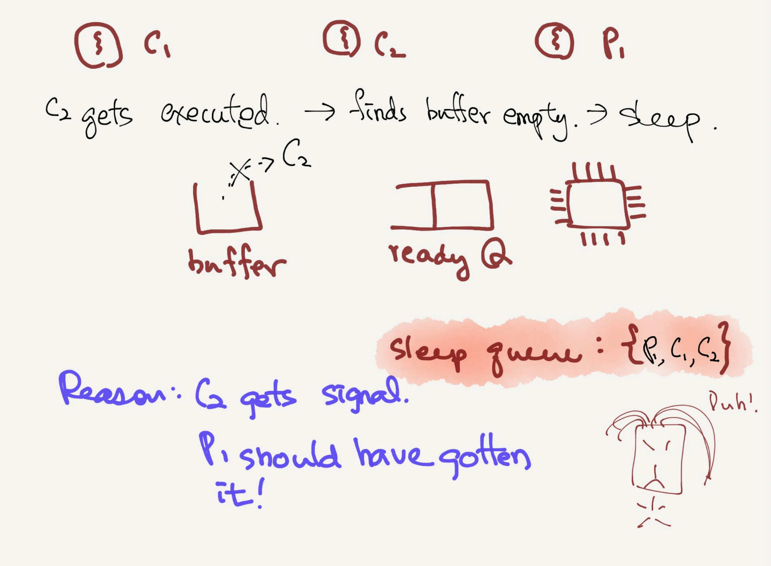

Slide 42
Thread Trace: Broken Solution (Version 2)
 | State |  | State |  | State | Count | Comment
c1 | Running |  | Ready |  | Ready | 0
c2 | Running |  | Ready |  | Ready | 0
c3 | Sleep |  | Ready |  | Ready | 0 | Nothing to get
 | Sleep | c1 | Running |  | Ready | 0
 | Sleep | c2 | Running |  | Ready | 0
 | Sleep | c3 | Sleep |  | Ready | 0 | Nothing to get
 | Sleep |  | Sleep | p1 | Running | 0
 | Sleep |  | Sleep | p2 | Running | 0
 | Sleep |  | Sleep | p4 | Running | 1 | Buffer now full
 | Ready |  | Sleep | p5 | Running | 1 | awoken
 | Ready |  | Sleep | p6 | Running | 1
 | Ready |  | Sleep | p1 | Running | 1
 | Ready |  | Sleep | p2 | Running | 1
 | Ready |  | Sleep | p3 | Sleep | 1 | Must sleep (full)
c2 | Running |  | Sleep |  | Sleep | 1 | Recheck condition
c4 | Running |  | Sleep |  | Sleep | 0 | grabs data
c5 | Running |  | Ready |  | Sleep | 0 | Oops! Woke

Slide 43
Thread Trace: Broken Solution (Version 2) (Cont.)
A consumer should not wake other consumers, only producers, and vice-versa.
 | State |  | State |  | State | Count | Comment
… | … | … | … | … | … | … | (cont.)
c6 | Running |  | Ready |  | Sleep | 0
c1 | Running |  | Ready |  | Sleep | 0
c2 | Running |  | Ready |  | Sleep | 0
c3 | Sleep |  | Ready |  | Sleep | 0 | Nothing to get
 | Sleep | c2 | Running |  | Sleep | 0
 | Sleep | c3 | Sleep |  | Sleep | 0 | Everyone asleep …

Slide 44
The single Buffer Producer/Consumer Solution
Use two condition variables and while
Producer threads wait on the condition empty, and signals fill.
Consumer threads wait on fill and signal empty.
1 cond_t empty, fill;
2 mutex_t mutex;
3
4 void *producer(void *arg) {
5 int i;
6 for (i = 0; i < loops; i++) {
7 Pthread_mutex_lock(&mutex);
8 while (count == 1)
9 Pthread_cond_wait(&empty, &mutex);
10 put(i);
11 Pthread_cond_signal(&fill);
12 Pthread_mutex_unlock(&mutex);
13 }
14 }
15

Slide 45
The single Buffer Producer/Consumer Solution
(Cont.)
16 void *consumer(void *arg) {
17 int i;
18 for (i = 0; i < loops; i++) {
19 Pthread_mutex_lock(&mutex);
20 while (count == 0)
21 Pthread_cond_wait(&fill, &mutex);
22 int tmp = get();
23 Pthread_cond_signal(&empty);
24 Pthread_mutex_unlock(&mutex);
25 printf("%d\n", tmp);
26 }
27 }

Slide 46
The Final Producer/Consumer Solution
More concurrency and efficiency → Add more buffer slots.
Allow concurrent production or consuming to take place.
Reduce context switches.
1 int buffer[MAX];
2 int fill = 0;
3 int use = 0;
4 int count = 0;
5
6 void put(int value) {
7 buffer[fill] = value;
8 fill = (fill + 1) % MAX;
9 count++;
10 }
11
12 int get() {
13 int tmp = buffer[use];
14 use = (use + 1) % MAX;
15 count--;
16 return tmp;
17 }
The Final Put and Get Routines

Slide 47
The Final Producer/Consumer Solution (Cont.)
1 cond_t empty, fill;
2 mutex_t mutex;
3
4 void *producer(void *arg) {
5 int i;
6 for (i = 0; i < loops; i++) {
7 Pthread_mutex_lock(&mutex); // p1
8 while (count == MAX) // p2
9 Pthread_cond_wait(&empty, &mutex); // p3
10 put(i); // p4
11 Pthread_cond_signal(&fill); // p5
12 Pthread_mutex_unlock(&mutex); // p6
13 }
14 }
15

Slide 48
The Final Producer/Consumer Solution (Cont.)
16 void *consumer(void *arg) {
17 int i;
18 for (i = 0; i < loops; i++) {
19 Pthread_mutex_lock(&mutex); // c1
20 while (count == 0) // c2
21 Pthread_cond_wait(&fill, &mutex); // c3
22 int tmp = get(); // c4
23 Pthread_cond_signal(&empty); // c5
24 Pthread_mutex_unlock(&mutex); // c6
25 printf("%d\n", tmp);
26 }
27 }
The Final Working Solution (Cont.)
p2: A producer only sleeps if all buffers are currently filled.
c2: A consumer only sleeps if all buffers are currently empty.

Slide 49
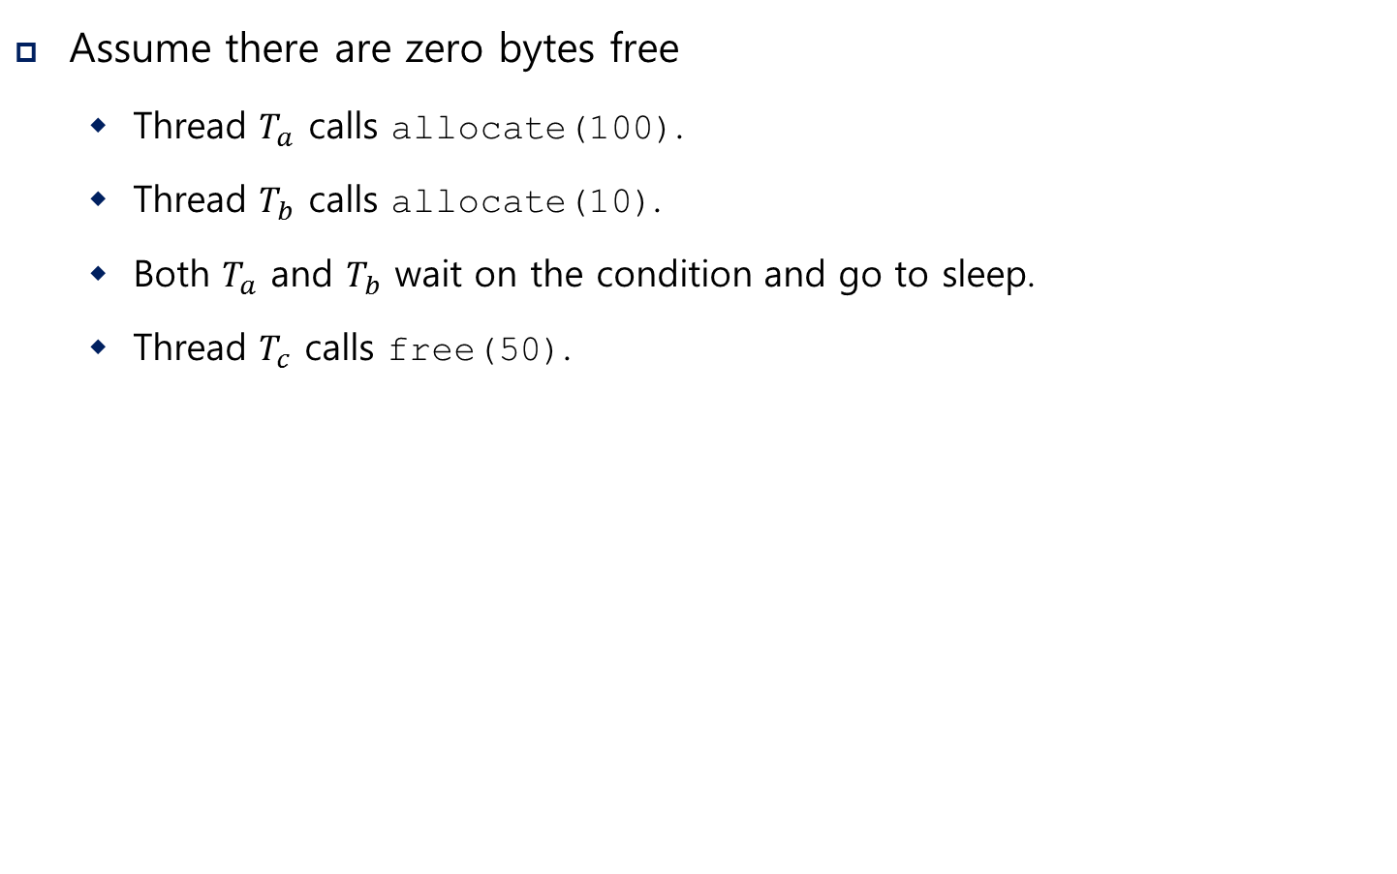
Covering Conditions
Assume there are zero bytes free
Thread $T_{a}$ calls allocate(100).
Thread $T_{b}$ calls allocate(10).
Both $T_{a}$ and $T_{b}$ wait on the condition and go to sleep.
Thread $T_{c}$ calls free(50).
Which waiting thread should be woken up?

Slide 50
Covering Conditions (Cont.)
1 // how many bytes of the heap are free?
2 int bytesLeft = MAX_HEAP_SIZE;
3
4 // need lock and condition too
5 cond_t c;
6 mutex_t m;
7
8 void *
9 allocate(int size) {
10 Pthread_mutex_lock(&m);
11 while (bytesLeft < size)
12 Pthread_cond_wait(&c, &m);
13 void *ptr = ...; // get mem from heap
14 bytesLeft -= size;
15 Pthread_mutex_unlock(&m);
16 return ptr;
17 }
18
19 void free(void *ptr, int size) {
20 Pthread_mutex_lock(&m);
21 bytesLeft += size;
22 Pthread_cond_signal(&c); // whom to signal??
23 Pthread_mutex_unlock(&m);
24 }

Slide 51
Covering Conditions (Cont.)
Solution (Suggested by Lampson and Redell)
Replace pthread_cond_signal() with pthread_cond_broadcast()
pthread_cond_broadcast()
Wake up all waiting threads.
Cost: too many threads might be woken.
Threads that shouldn’t be awake will simply wake up, re-check the condition, and then go back to sleep.

